Slide 1
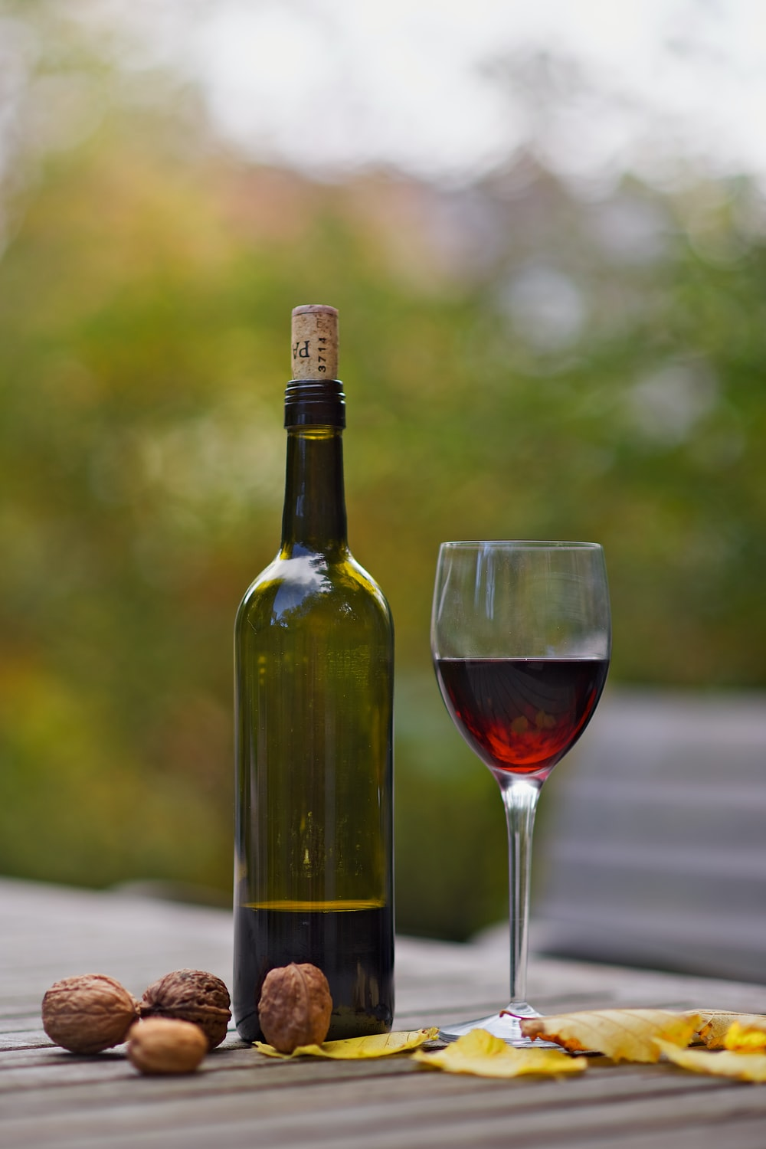
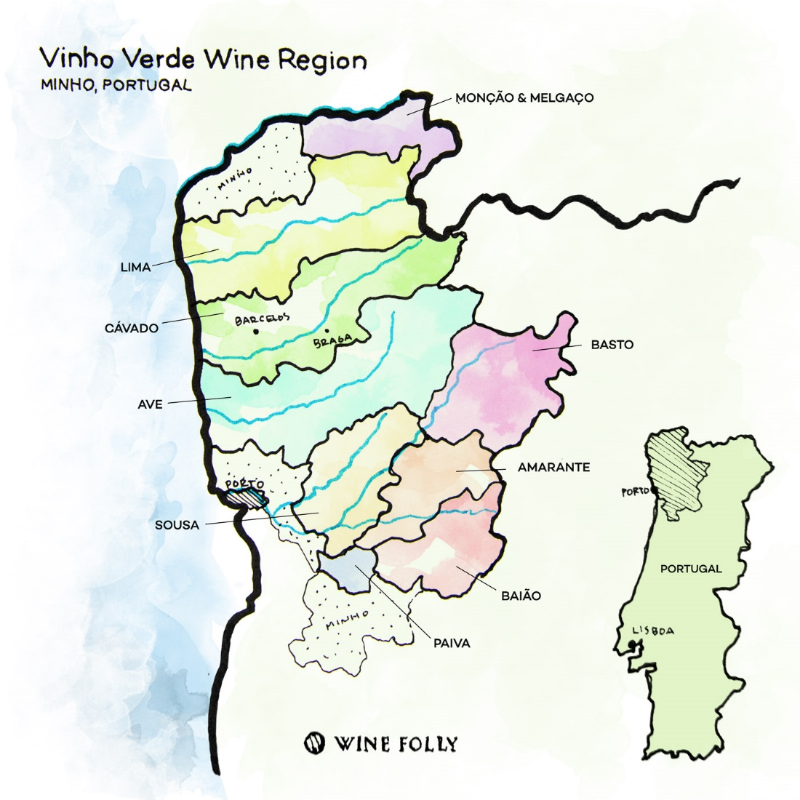
Quinta De Soalheiro: Chief Oenologist
Vinho Verde Wine Region - Portugal

Slide 2
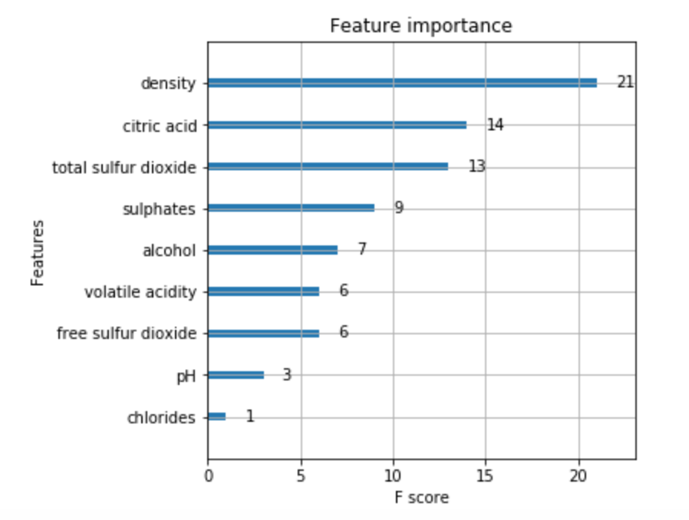
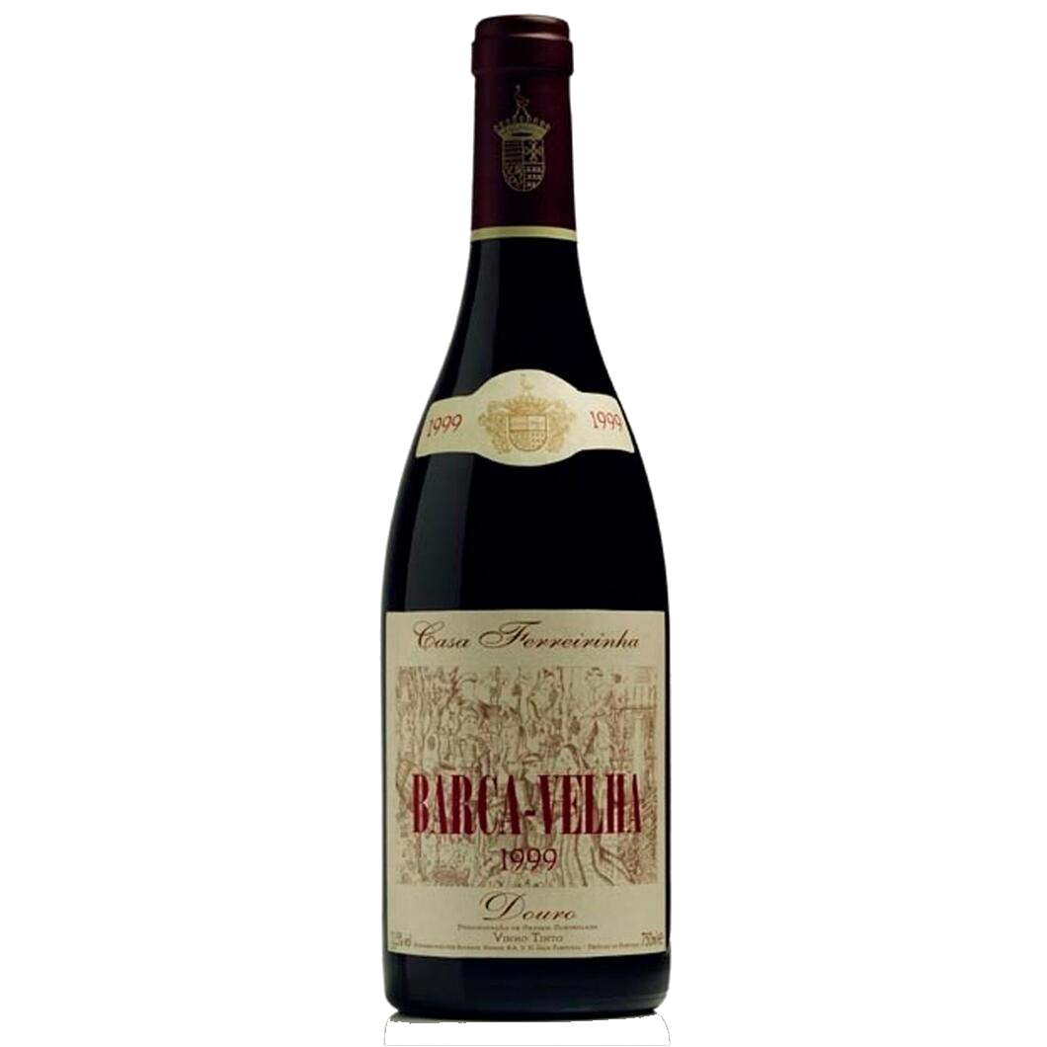
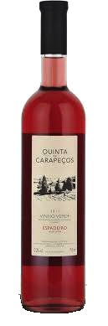
Feature Importance
Low quality
Airy
Low alcohol
High quality
Dense
Sharp acidity
Significance to Portugal
Dietary
Geographic
Historical

Slide 3
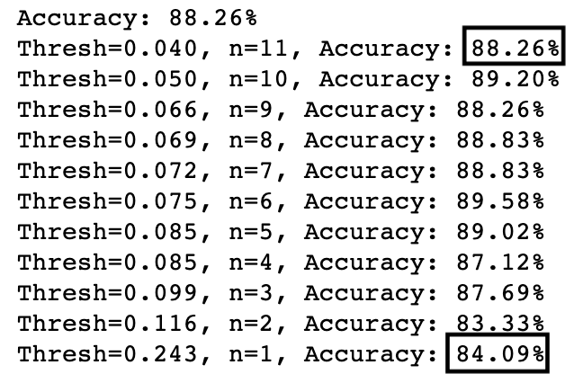
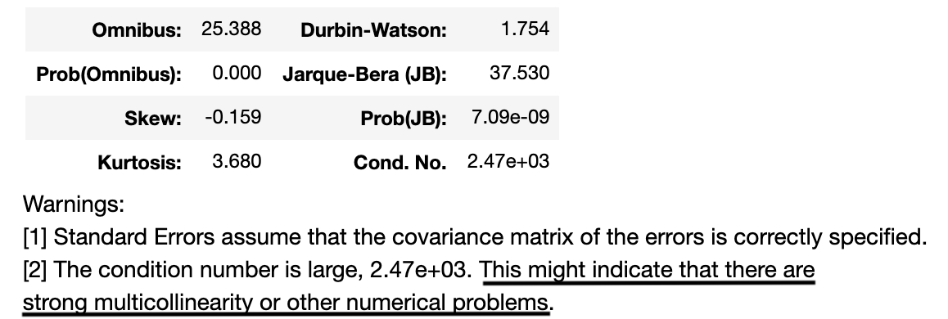
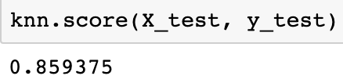
Feature Importance
Predictive application
Adequate forecasting with small number of features
Suggests high correlation between independent variables

Slide 4
Jake – Chief Oenologist
Distinct Qualification:
Proprietary process to consistently produce a high quality product
Executive Summary…
Discovery Matrix:
Identifies key relationships of core product characteristics (Qty and % Mix).
Performance Dispersion:
Identifies distribution of core product characteristics
Average Stack
Provides segmentation and scale of core product characteristics
Ranked Heat Map
Provides relationship trends
Data Driven Results Mapping
Provides recipe targets of core product characteristics
https://public.tableau.com/profile/garet.douglass#!/vizhome/WineProject_15960396866710/TargetMeasuresScatter?publish=yes

Slide 5
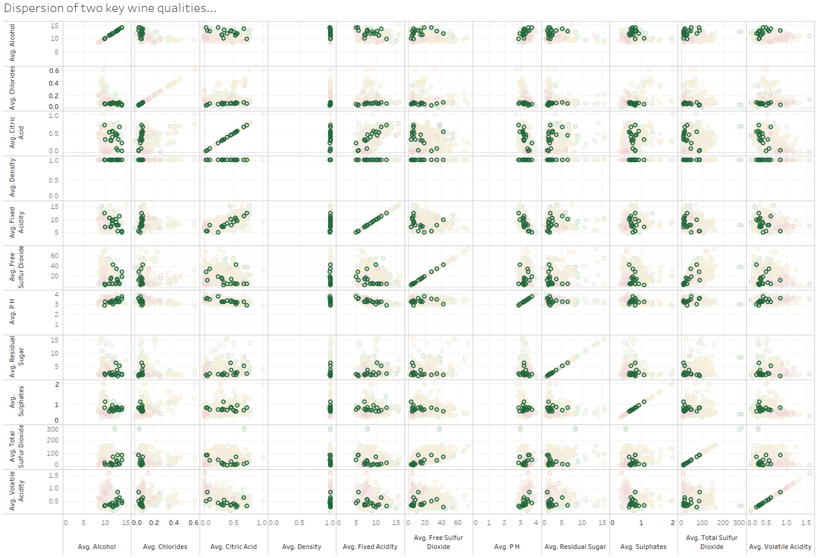
Discovery Matrix: Qty
Identify relevant relationships & correlations
Notes:
Summarize your research in three to five points.

Slide 6
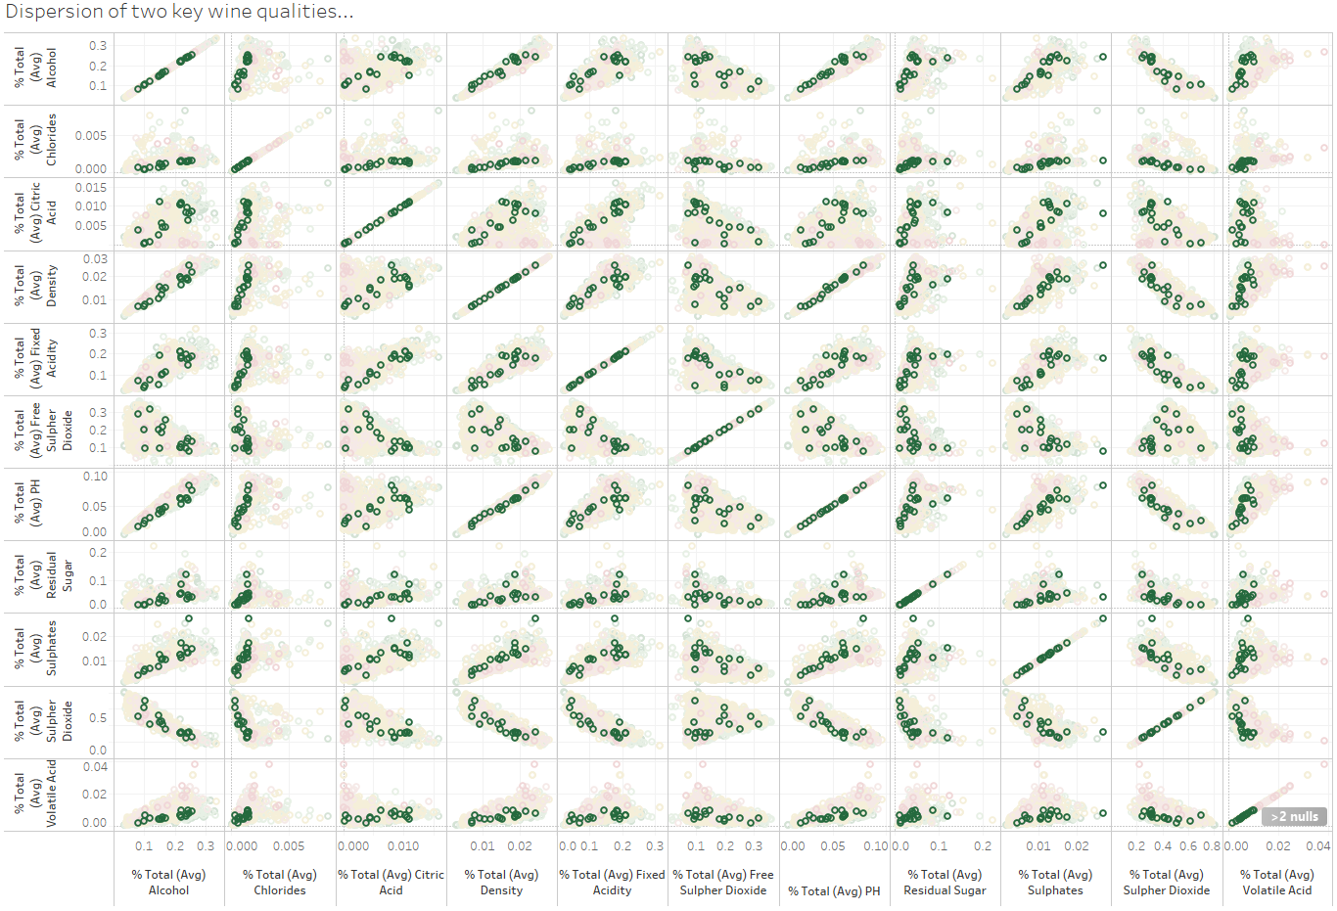
Discovery Matrix: % Mix
Notes:
Summarize your research in three to five points.

Slide 7
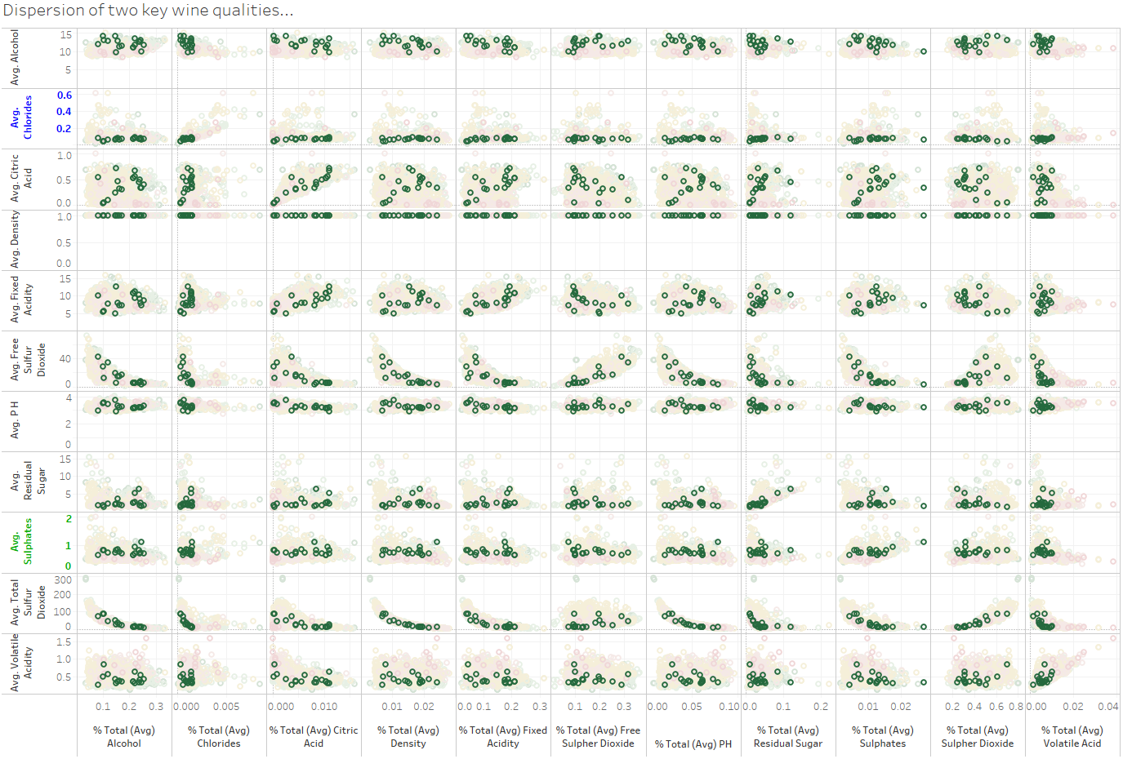
Discovery Matrix: % Mix vs. Quantity
Notes:
Summarize your research in three to five points.

Slide 8
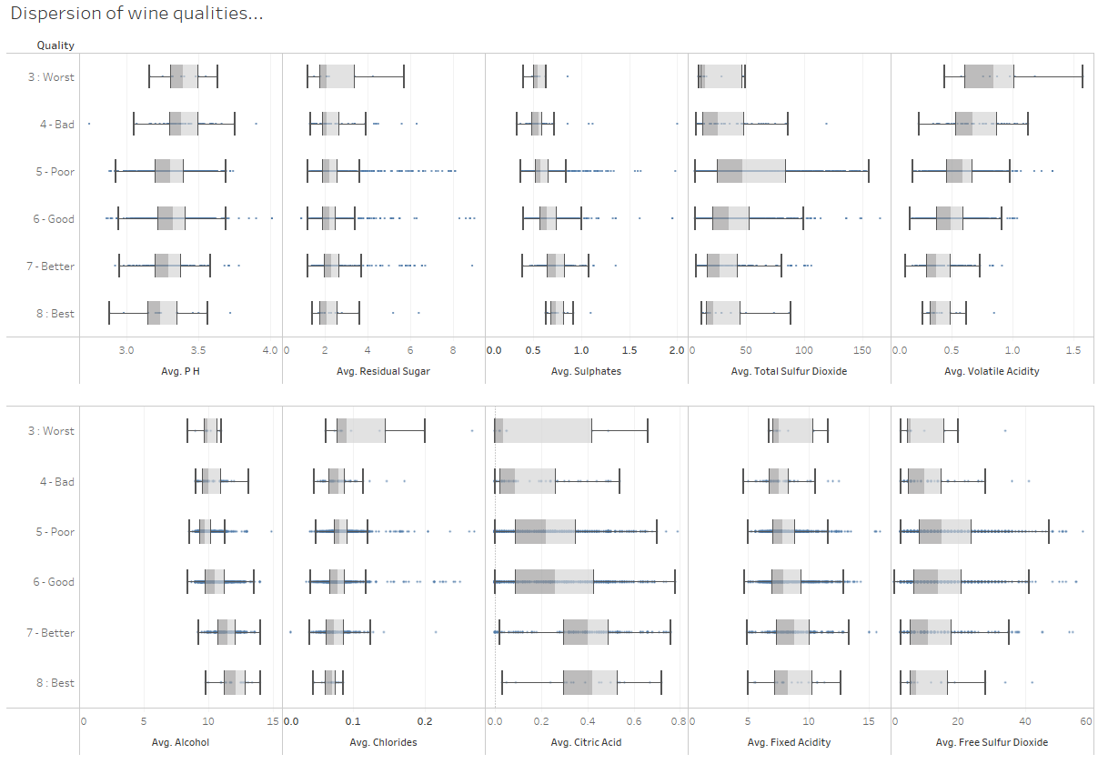
Performance Dispersion

Slide 9
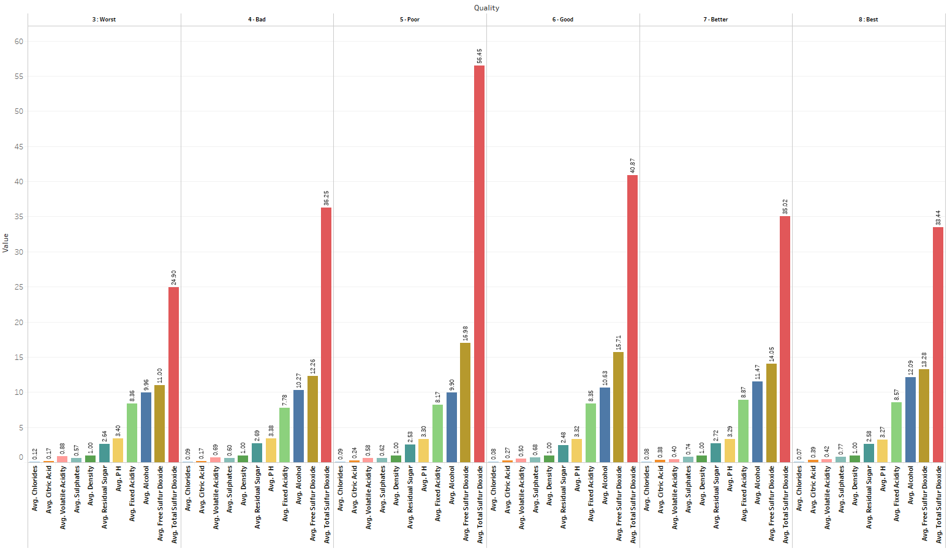
Average Stack

Slide 10
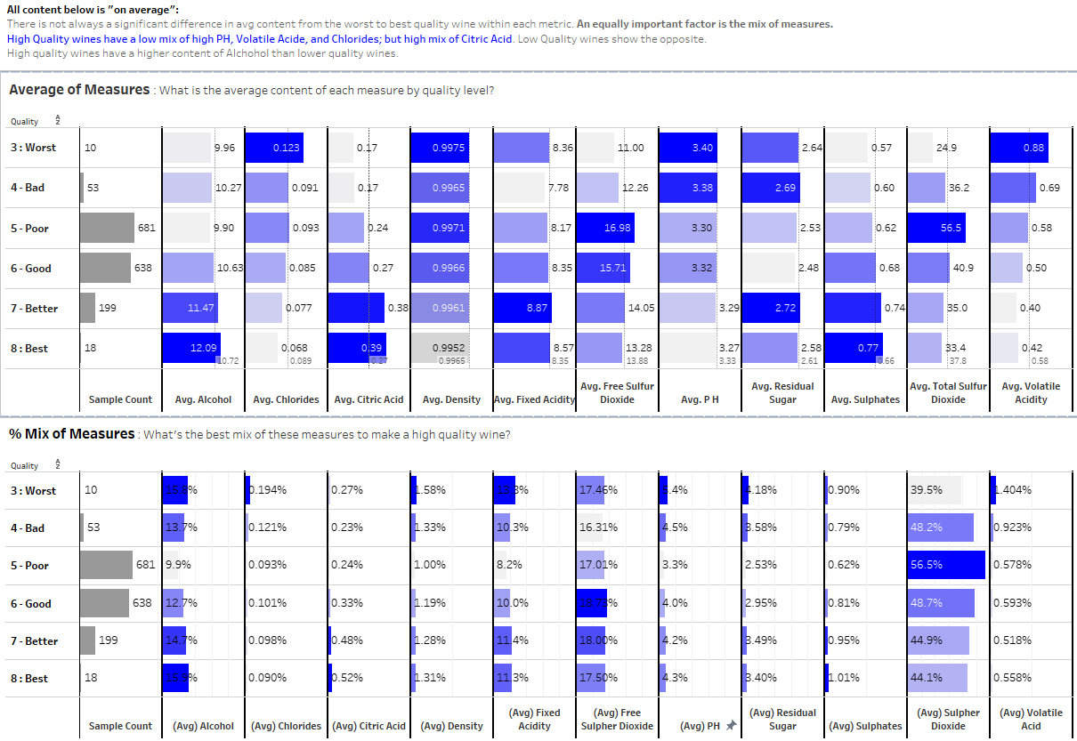
Ranked Heat Map

Slide 11
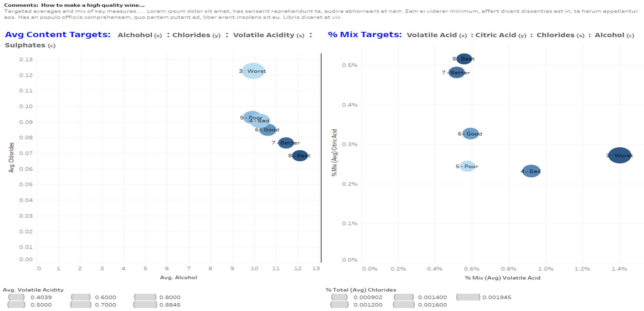
Data Driven Results Mapping: What makes a high quality wine…
Key Findings:
Content:
Alcohol
Chlorides
Volatile Acidity
Sulphates
Mix:
Volatile Acid
Citric Acid
Chlorides
Alcohol

Slide 12
Conclusion
Brief summary of what you discovered based on results

